Slide 1
Weekly meeting
5 9 2024
Ty Bottorff

Slide 2
Outline
Exploring DP cell sort differences vs. DN
Literature evidence for Alice W.’s data

Slide 3
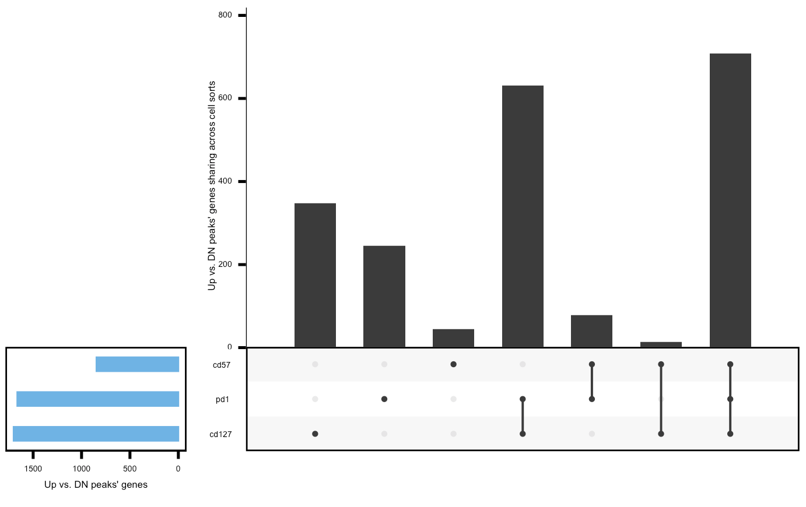
Sharing of peaks’ closest genes/promoters doesn’t follow expectation of DP CD127⁺ being a distinct lineage with more sharing between DP PD-1⁺ and DP CD57⁺
filtered for differentially accessible peaks with highest abs(FC) per gene (or promoter, similar results if using median)
then filtered for FC > 0 vs. DN
similar results if filtering for peaks < 5 kb from genes
Notes:
Looks similar for promoters
This seems to point to CD57+ being like the others (low unique genes) with other 2 being more distinct…

Slide 4
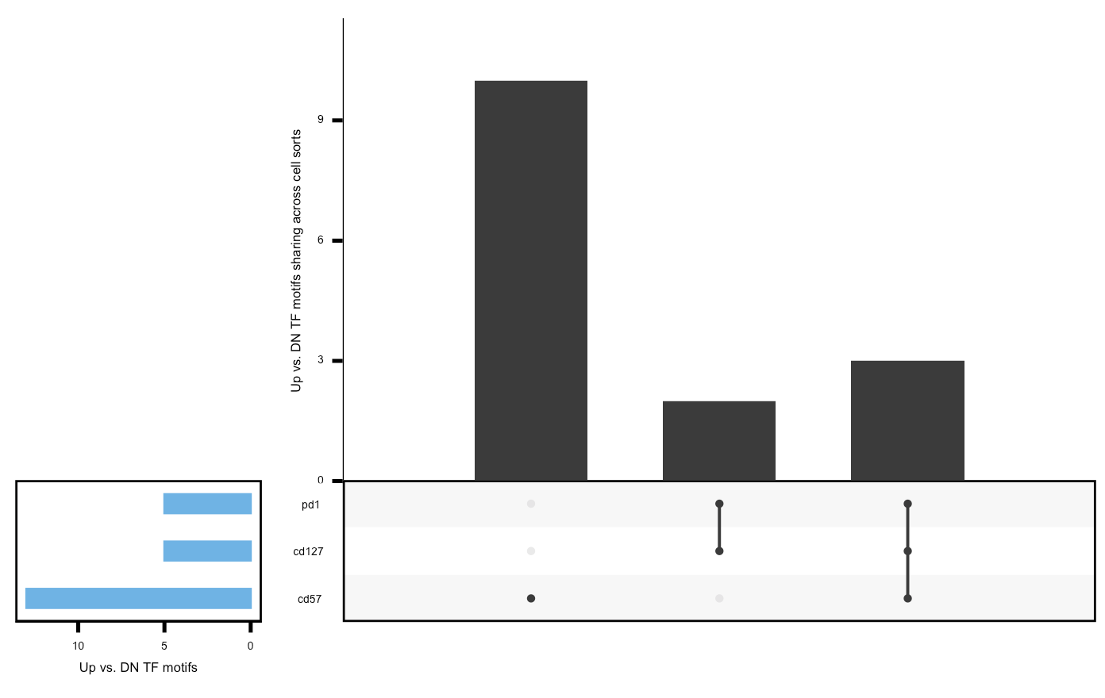
Homer known TF motif analysis results don’t follow expectation of DP CD127⁺ being a distinct lineage with more sharing between DP PD-1⁺ and DP CD57⁺, instead DP CD57⁺ seems to be distinct lineage
Filtered motifs for p < 1e-25
Background for motif discovery: peaks up in DN vs. each DP
(potentially fixes issue of same TF motif showing up in both up/down
peaks in a contrast)
Notes:
Known motif enrichment in peaks up in each DP vs. DN
Since HOMER is a differential motif discovery algorithm, it must use background sequence regions as a control. By default, HOMER selects enough random background regions such that the total number of regions is 50000 or 2x the total number of peaks, which ever is larger,
So it’s not surprising that p vals are lower on right (smaller background)
This seems to point to CD57 being more unique…
Same if looking at just motif or TF

Slide 5
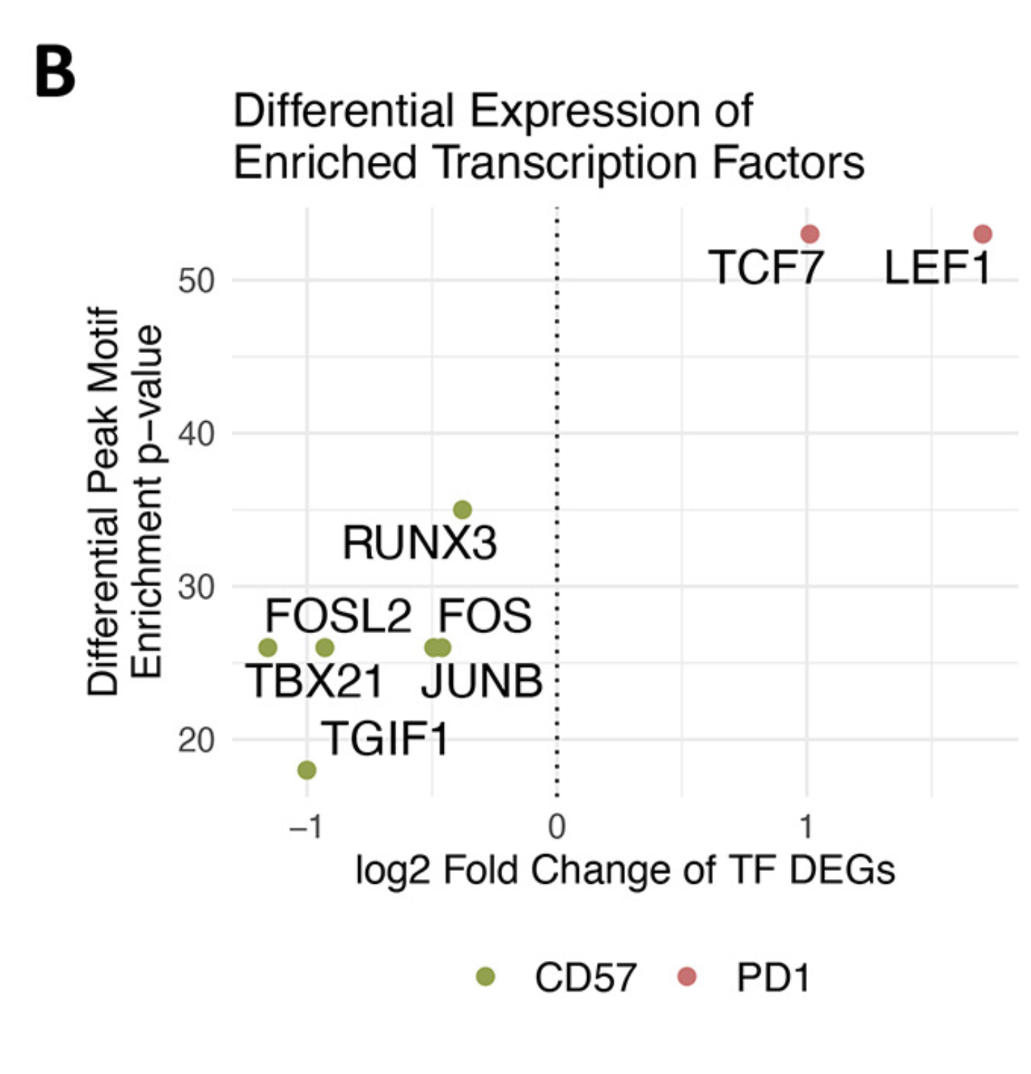
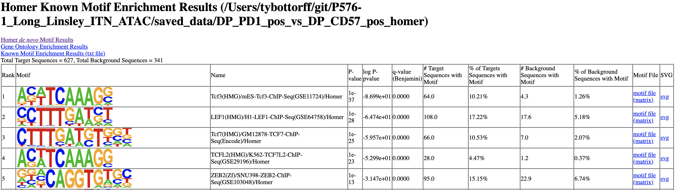
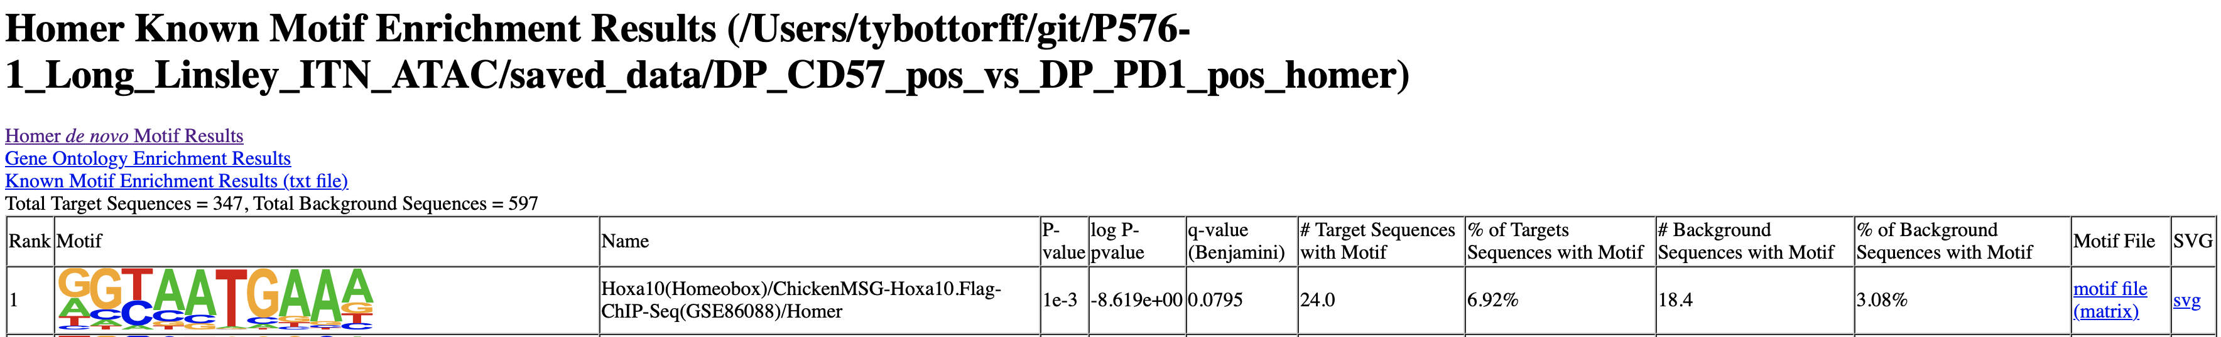
Homer known TF motif analysis: DP PD-1⁺ vs. DP CD57⁺ (and vice versa) somewhat agrees with Erin’s data

Slide 6
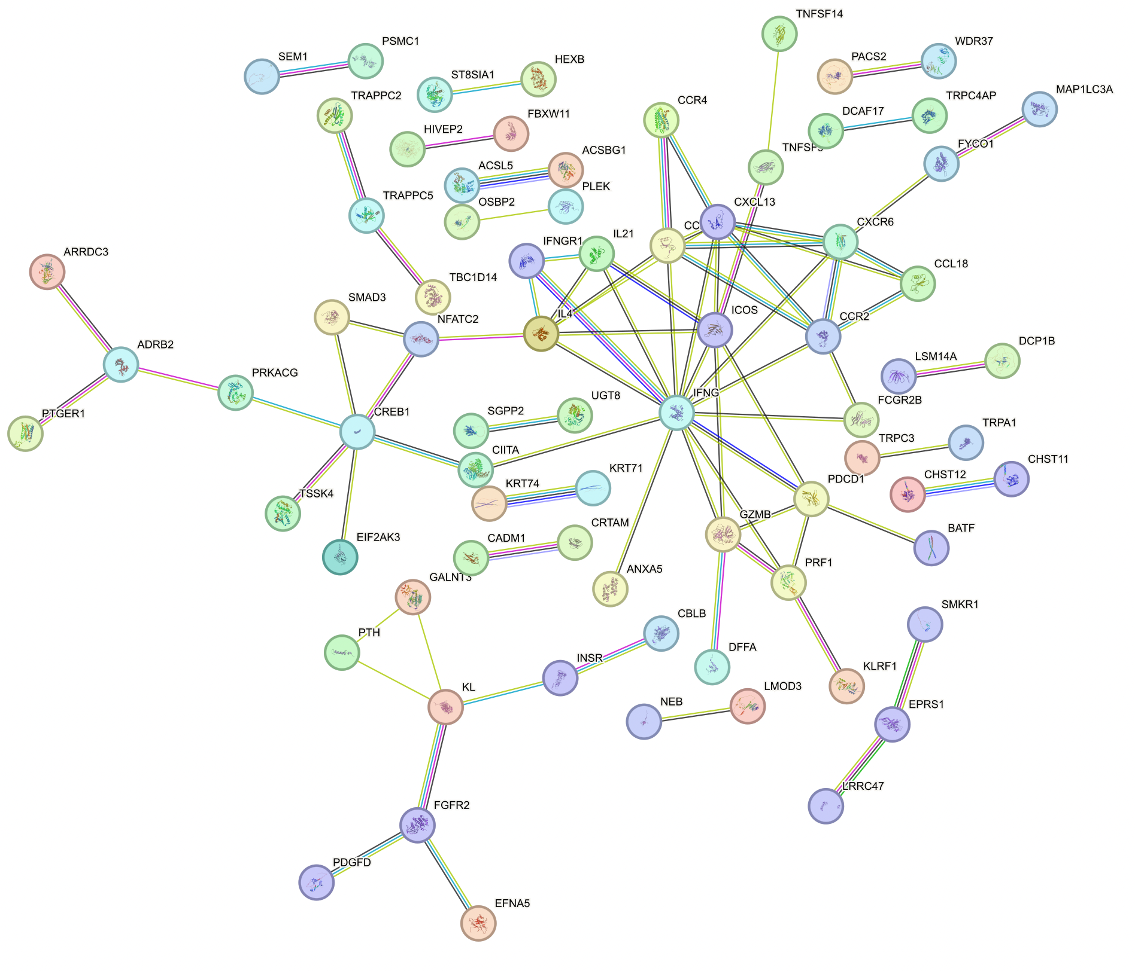
PPI: genes up in DP PD-1+ vs. DN
High confidence interactions
Hiding disconnected nodes
PPI enrichment p val: 3e-06
Top GO terms: T cell chemotaxis, positive regulation of NK cell mediated cytotoxicity
Top KEGG pathways: TCR signaling pathway, Th17 cell differentiation
IFGN cluster shared with other DP vs. DN (genes)
CREB1 cluster seems distinct
Notes:
No peak filtering
CREB1 promotes cytotoxicity?

Slide 7
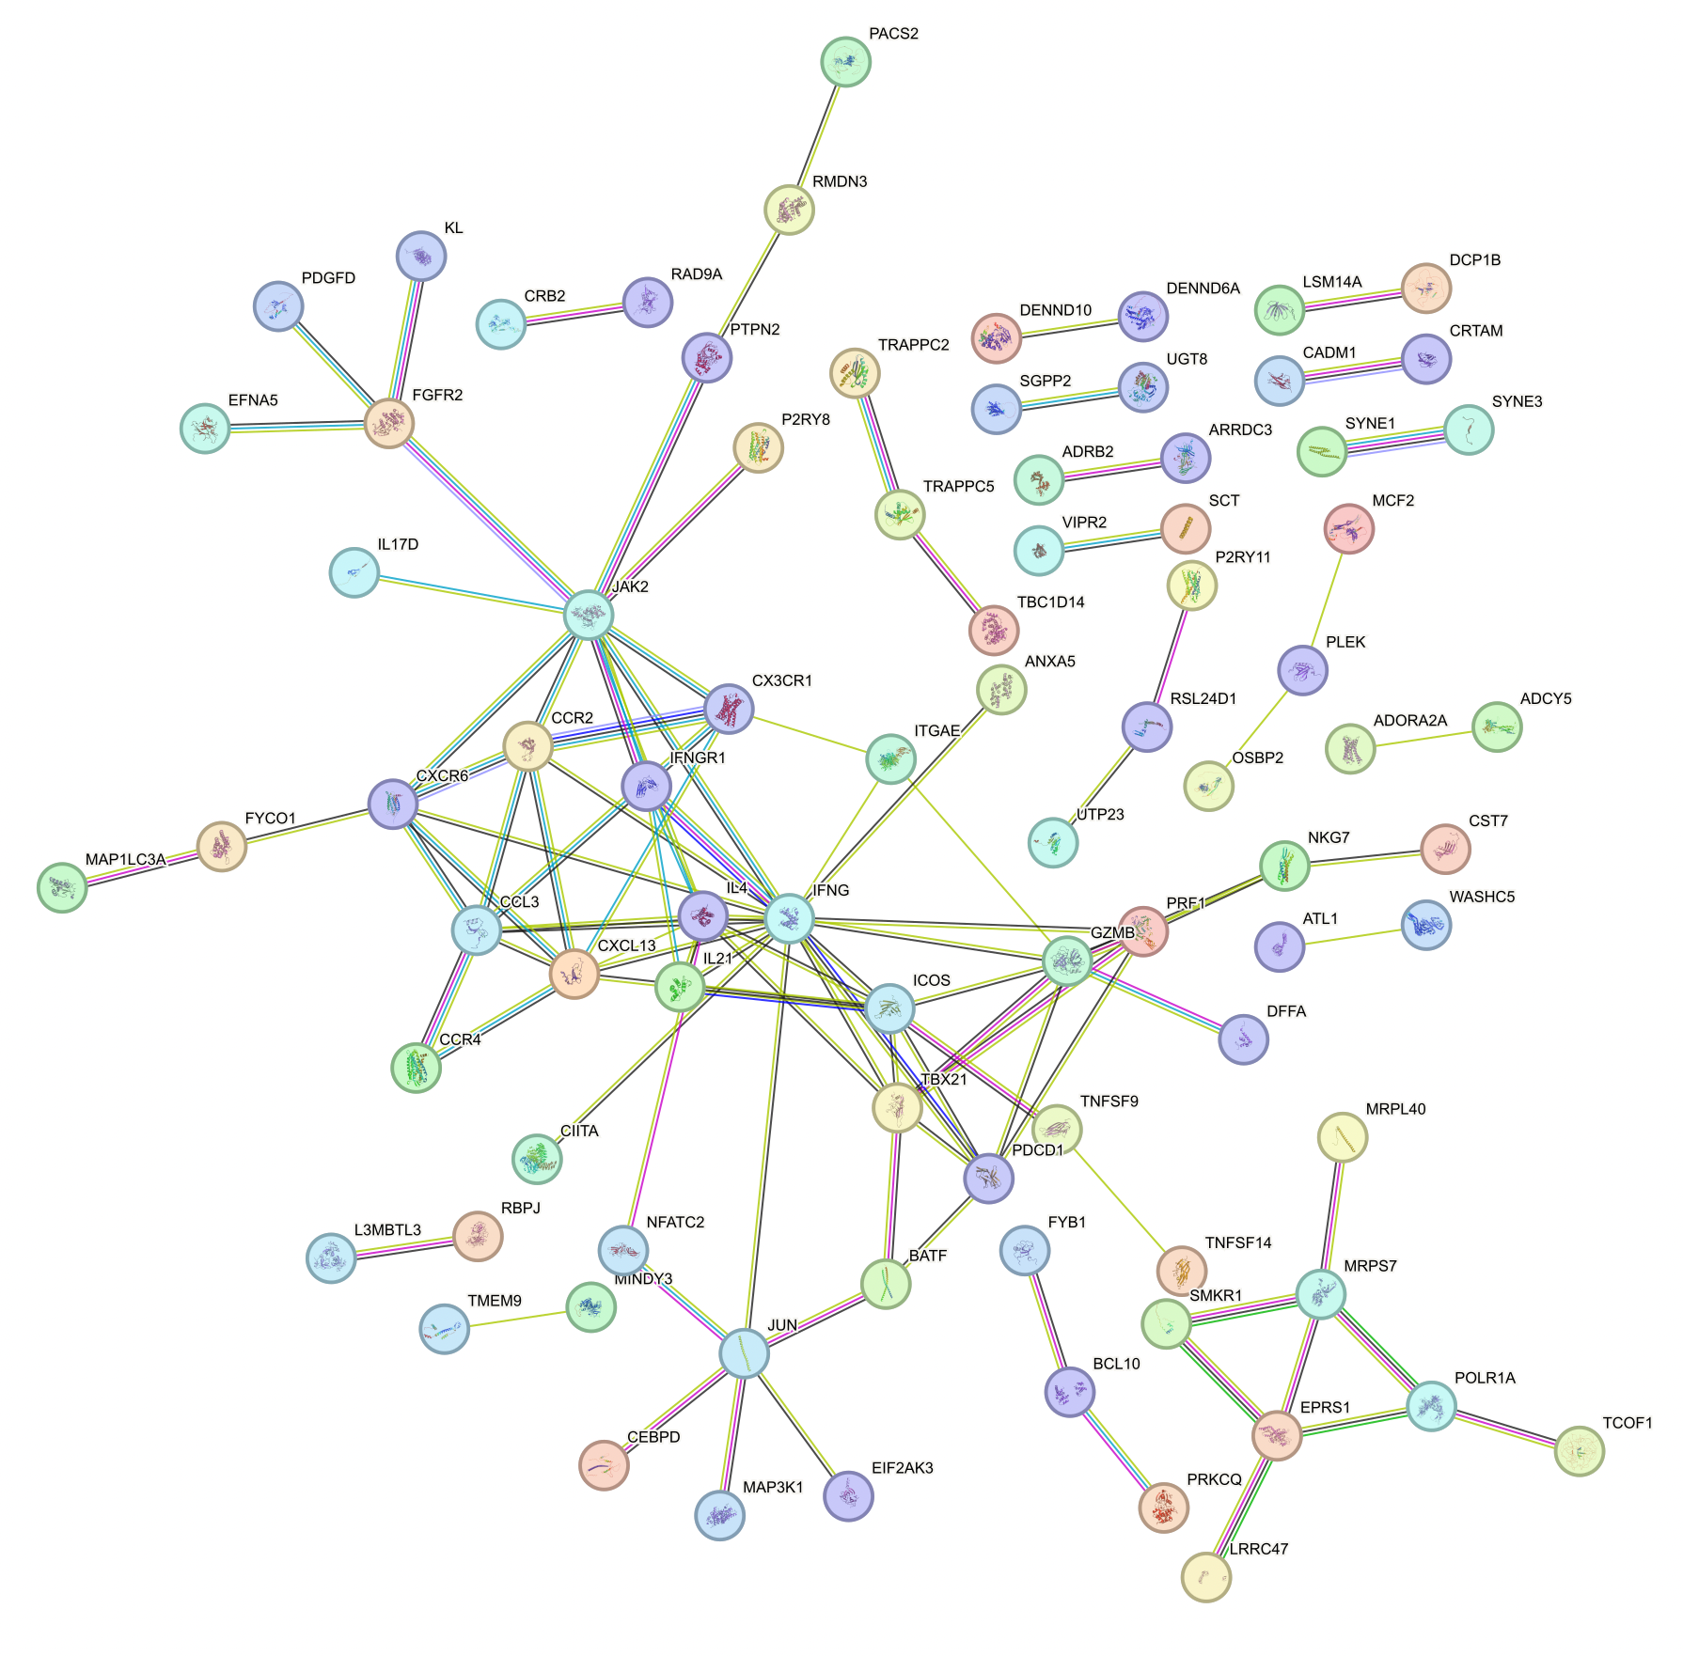
PPI: genes up in DP CD57+ vs. DN
High confidence interactions
Hiding disconnected nodes
PPI enrichment p val: 1.06e-08
Top GO terms: positive regulation of MHCII biosynthesis, T cell chemotaxis, glial cell stuff...
Top KEGG pathways: Th1/2/17 cell differentiation, PD-L1 expression and PD-1 checkpoint pathway in cancer, IBD, TCR signaling
IFGN cluster shared with other DP vs. DN (genes)
JUN and bottom right clusters seem distinct
Notes:
No peak filtering
Jun related to activation?
EPRS1 drives T cell proliferation/activity

Slide 8
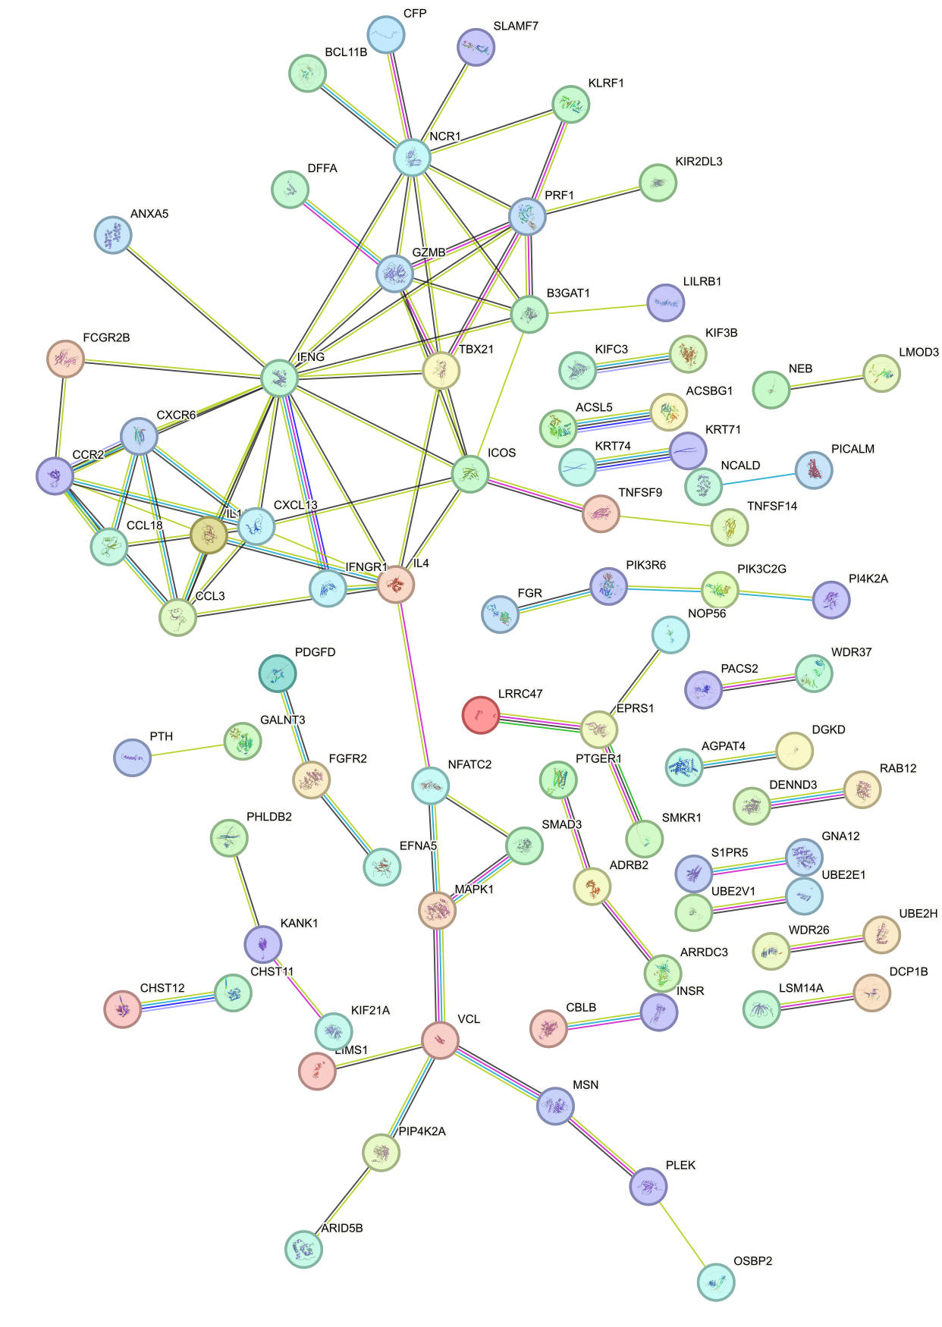
PPI: genes up in DP CD127+ vs. DN
High confidence interactions
Hiding disconnected nodes
PPI enrichment p val: 8.23e-09
IFGN cluster shared with other DP vs. DN (genes)
VCL cluster seems distinct
Notes:
No peak filtering

Slide 9
Alice W.’s data in context: ICI leads to…
Higher fraction Treg in CD4s
~Agreement: more Tregs in ICI treated group (PMID35762356)
Higher fraction granzyme B positive in non-naïve CD8s
~Agreement: increased GZMK⁺ PDCD1⁺ CD8 TEMs after ICI (PMID36787939)
Lower fraction PD-1⁺ in CD8 TEMs
~Disagreement: increased proliferation from anti-PD-1 in PD-1⁺ CD8s (PMID28397821)
Lower fraction ICOS⁺ in T_{fh} CD4 T_{conv} cells
Disagreement but for CTLA-4 blockade not PD-1 blockade: increased ICOS⁺ CD4 T cells biomarks CTLA-4 blockade (Clonal expansion of CD8 T cells in the systemic circulation precedes development of ipilimumab-induced toxicities)
Higher fraction TIGIT⁺KLRG1⁺ in non-naïve CD8s

Slide 10
Alice W.’s data in context: baseline blood of irAE developers has…
Lower fraction TIGIT⁺KLRG1⁺ in non-naïve CD8s
Higher fraction CD27⁻IgD⁻ in B cells
Decreased B cells, increased plasmablasts and CD21^{low} PD-1⁺ memory B cells associated with higher irAE risk (PMID29309049)
Reduced peripheral B cells in irAE patients (PMID:36909522)
High CD2^{low} PD-1⁺ B cells at baseline predicts irAE development (PMID35432346)
Lower fraction CXCR3⁺ in non-naïve CD4 T_{conv}

Slide 11
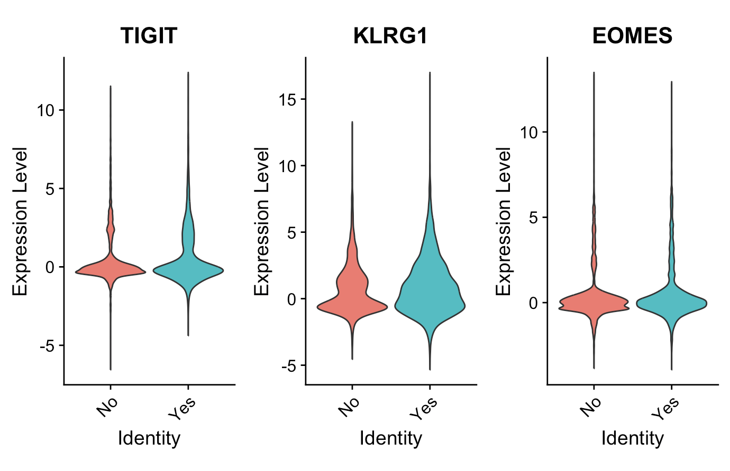
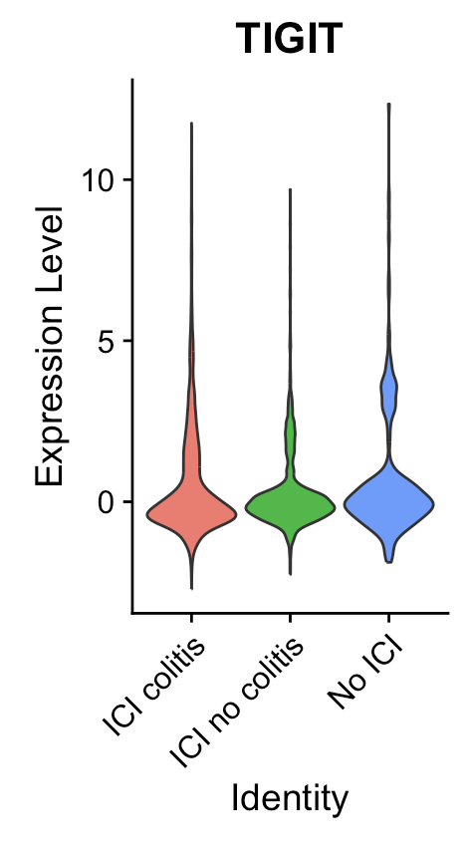
TIGIT and KLRG1 levels may actually appear higher in non-naïve CD8s from PBMCs in myocarditis irAE dataset, TIGIT also slightly higher in 1 of 2 colitis datasets in irAE group (~no difference in other dataset)
irAE status
Notes:
Thomas 2022 colitis dataset

Slide 12
Conclusions
Peak gene/promoter and known TF motif DP sharing vs. DN analysis doesn’t really follow expectations of DP CD127⁺ being unique lineage from peak clustering data and don’t really agree with each other
Unique TFs for DP CD57⁺ lineage may drive fate (need to check for de novo motifs)
AP-1, Atf3, Bach2, BATF, Fos(l2), Fra1/2, JunB/AP
Do see central IFNG-IL4 cluster present in all 3 genes DP vs. DN PPIs and 2 of promoter PPIs (not DP CD127⁺, data not shown)
TIGIT and KLRG1 unexpectedly slightly higher though in non-naïve CD8s in irAE group in myocarditis PBMC dataset (Zhu 2022), TIGIT higher in 1 of 2 colitis datasets (Thomas 2021)
Notes:
Homer points to CD57 being unique, gene/promoter sharing points to it being like the others...

Slide 13
Next steps
Homer
Reconsider appropriate background choice
Incorporate de novo motif results (only looked at known motifs so far, which has advantage with less sequences)
Explore more pairwise DP comparisons
Prepare for 5/21 code review and 5/23 SI
Notes:
De novo motif discovery allows you to directly query the sequence to discover which motifs are the MOST enriched sequences in your target set. Known motif discovery will simply tell you which of the known motifs is most enriched in your target set
The greatest advantage to using known motifs is found when you have a limited set of target sequences. The less data that is available or the weaker the true signal, it is difficult for de novo motif finding to accurately define a signal that is significant. Known motifs have the advantage of many less degrees of freedom and in may cases find the correct motifs when the enrichment falls below the 1e-10 thresholds for reliability when considering de novo results

Slide 14
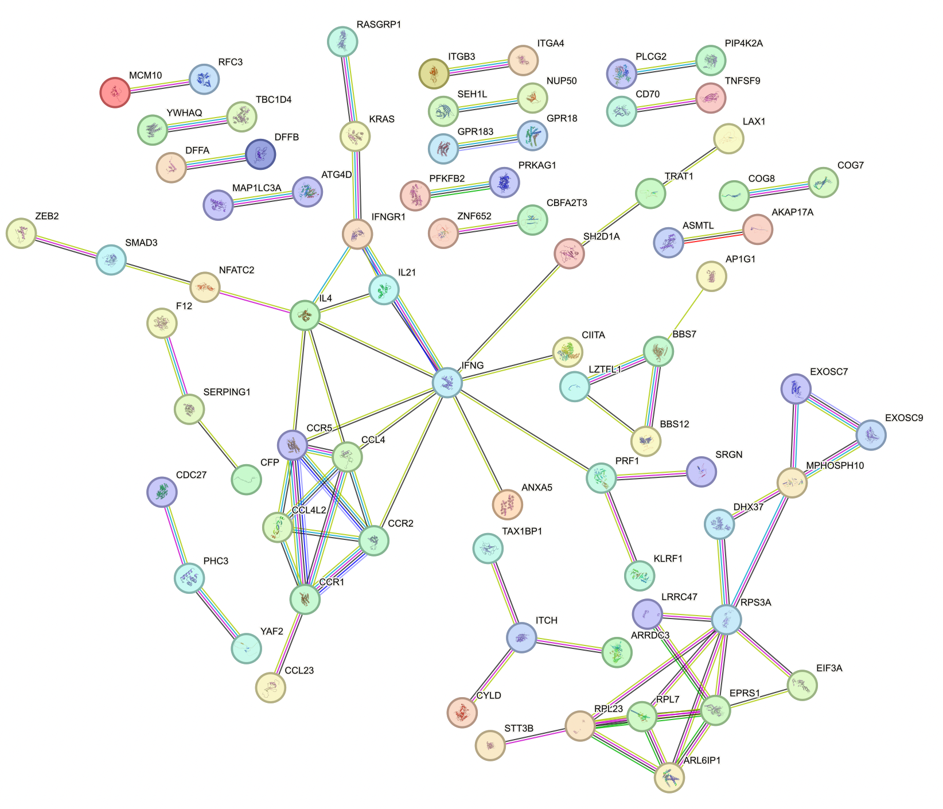
PPI: promoters up in DP PD-1+ vs. DN
High confidence interactions
Hiding disconnected nodes
PPI enrichment p val: 0.0002
Top GO term: positive regulation of immune system processes
IFGN cluster shared with DP CD57⁺ vs. DN (promoters)
Notes:
No peak filtering
CREB1 promotes cytotoxicity?

Slide 15
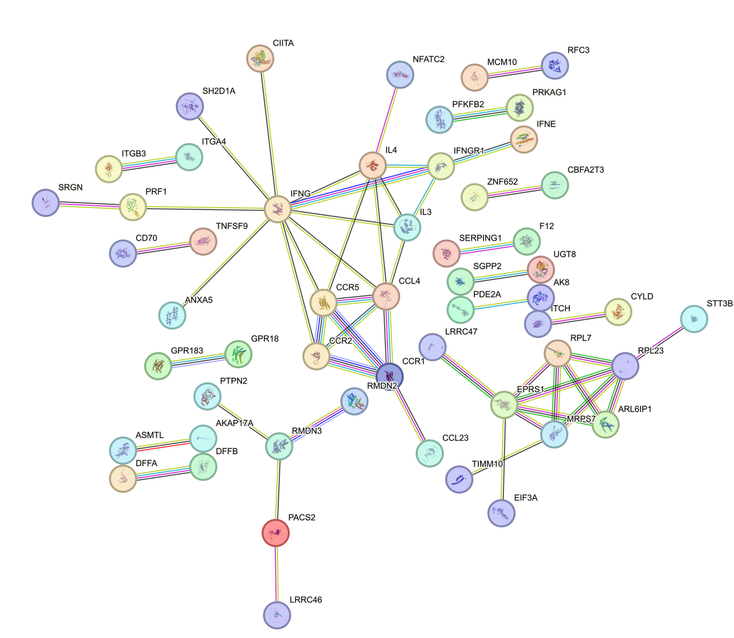
PPI: promoters up in DP CD57+ vs. DN
High confidence interactions
Hiding disconnected nodes
PPI enrichment p val: 0.0097
Top KEGG pathway: cytokine-cytokine receptor interaction
IFGN cluster shared with DP PD-1⁺ vs. DN (promoters)
Notes:
No peak filtering
Jun related to activation?
EPRS1 drives T cell proliferation/activity

Slide 16
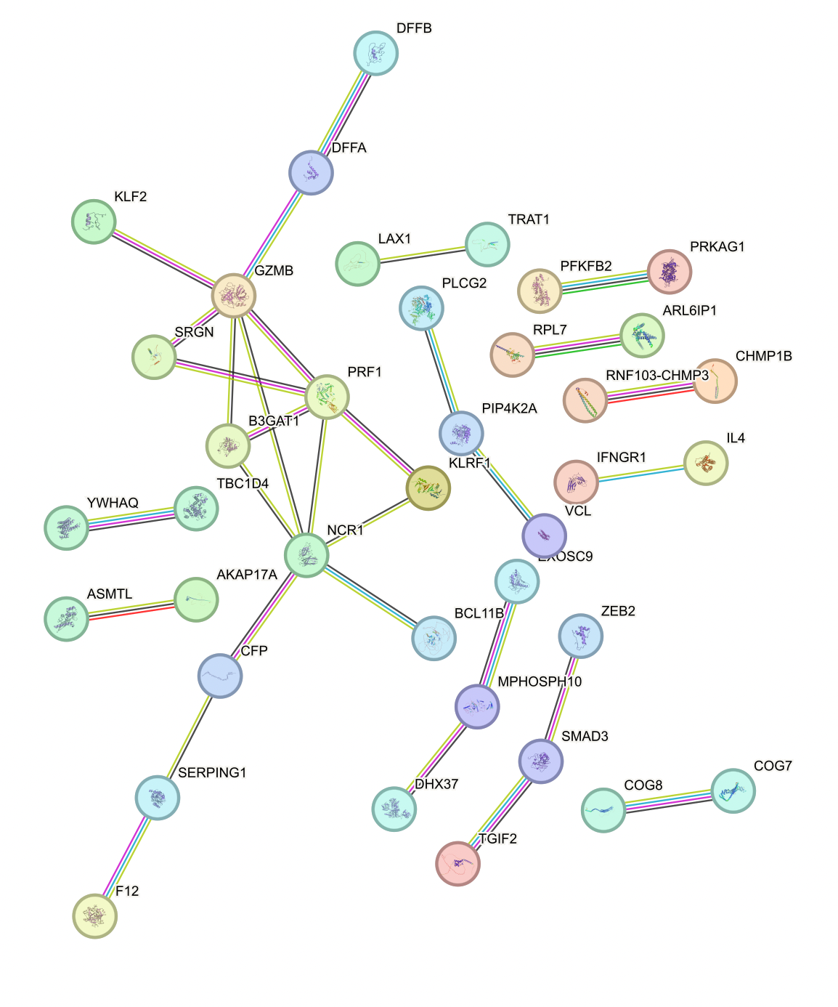
PPI: promoters up in DP CD127+ vs. DN
High confidence interactions
Hiding disconnected nodes
PPI enrichment p val: 0.1
Notes:
No peak filtering

